Slide 1

presentation by, Arjun Rao, dept of CSE Anjana Joshi, dept of I.T Bhagirathi Hegde ,Junaid Shigli, dept of ECE arjunrao007@gmail.com,anjana2492@gmail.com, bhagirathihegde488@gmail.com,junaidshigli12@gmail.com
MOBILE AGENTS AND APPLICATIONS
B. V. Bhoomaraddi College of Engineering & Technology
Hubli
www.bvb.edu

Slide 2
Contents
Objective
Introduction
Properties
Working
Existing mobile agent framework system
Mobile agent based -banking system
Few more applications
Comparative study of mobile and static agents
Security concerns
Conclusion

Slide 3
Objective
To study the working and properties of mobile agents.
Application of mobile agents to banking system.

Slide 4
Introduction
Mobile agents are migratory programs.
Perform tasks in the network on behalf of their creators.
It has great potential for network applications.
It has not been widely deployed.

Slide 5
Properties
Artificial intelligence
Autonomy
Communicative ability
Adaptability and Responsiveness

Slide 6
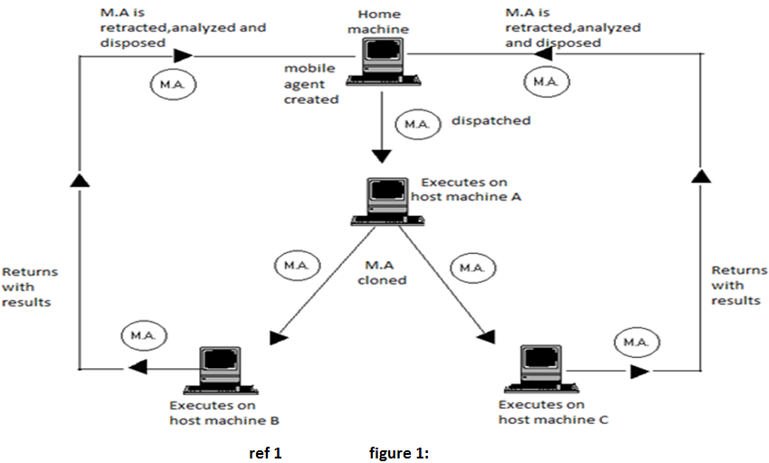
Working of mobile agents

Slide 7
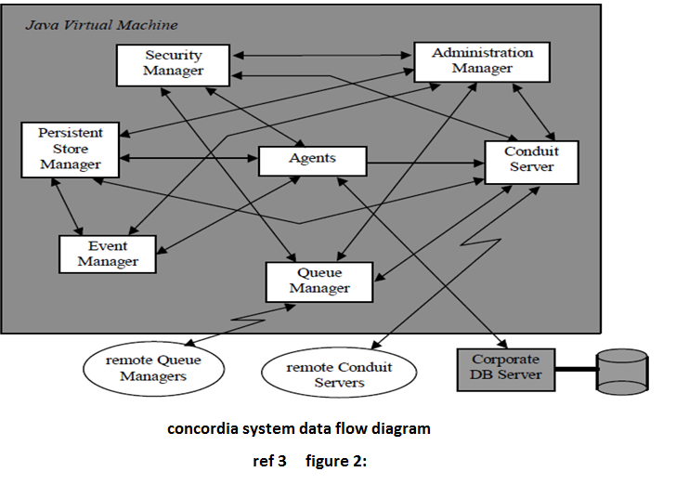
Existing mobile agent framework system: Concordia

Slide 8
Concordia is an infrastructure for collaborating mobile agents developed by Mitsubishi electrica USA.
The major blocks in this system are:
Conduit Server : propagation server.
Persistent Store Manager: allows the internal state of agent objects to become persist able.
The Queue Manager: manages inbound and outbound queues for reliable transport of agents across a network.
Administration-Manager: handles the system administration.
Concordia Security Manager: a Java object owned by the Java VM manages resource protection.
Event manager: manages the events of the agent.

Slide 9
Agent mobility mechanism
As an agent travels around a network its byte codes and the byte codes of any objects it creates and stores in its member variables are loaded via a special “Class Loader”.
This Class Loader packages theses byte codes into a special data structure which travels with the agent.
During the de-serialization of the agent, the byte codes for the agent and its related classes can be retrieved from this data structure and are used to instantiate a new copy of the agent.

Slide 10
Secured Authenticated Mobile Agent Based E-Banking System
Applications that allow users to complete banking transaction.
A customer can send a mobile agent to perform various tasks involved in banking and get back an appropriate result.
Customer Dispatches one or more Mobile Agents.
The MA visits each bank server in turn to perform the required transaction.
If the desired account is present, it processes the transaction on behalf of the user, or it moves to other bank servers.

Slide 11
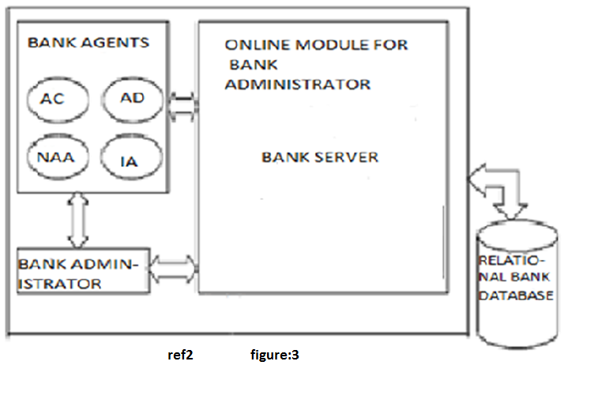
Architecture and Design of the Banking System based on Mobile Agents

Slide 12
Types: differ mainly in the roles covered and/or services offered during trading transactions.
Bank Agent(BA)
Customer Agent(CA)
Different processes between BA and CA:
Opening a bank account.
Closing a bank account.
Getting information from an account.

Slide 13
Bank Server
Central module of the application.
All the functionality of the bank resides here.
All MAs report to this module
It has four stationary agents:
Authenticator Credit (AC)
Authenticator Debit (AD)
New Account Agent (NAA)
Insurance Agent (IA)

Slide 14
A customer MA uses the services of these bank agents to perform the required transactions.
Customer MAs do not themselves fetch, search or update the bank database.
This is done for enhancing the security of the system.
The stationary agents perform the actual transaction and inform the customer MAs .
The database is opened in read mode only.

Slide 15
The Agents used in this Application
BFindAgent
Agent Debit
Agent Credit
New Account Agent
Query Agent

Slide 16
Few more applications
E-learning
Personal assistant: handles shopping and other affairs

Slide 17
Comparative study
Comparative study
Static agents | Mobile agents
Centralized execution | Decentralized execution
Sits idle until a higher priority job is completed and hence consumes much of the processor time | If processor is involved in a higher priority job; moves to next machine thereby saving time
Executes on a single machine | Can distribute itself among multiple processors using parallel processing
Moves data to computation, results in a lot of network traffic | Moves computation to data reducing network load
Consumes lot of bandwidth in series of queries | Series of queries are avoided conserving the bandwidth

Slide 18
Security concerns
A virus can be disguised as a mobile agent and distributed in the network.
This can be avoided by introducing tracing mechanisms to record execution of mobile agent at each host.

Slide 19
Conclusion
Mobile agents adds new dimension to distributed computing.
It will be widely accepted if security issues are properly addressed.
It can revolutionize the technology and bring a change in the society.

Slide 20
References
1.Mobile agents: intelligent assistants on the internet ,Parineeth. M. Reddy, IISC.
2.A comparative study of mobile agent and client-server technologies in a real application , R.B.Patel, K Garg ,IIT Roorkee .
3.Concordia: an infrastructure for collaborating mobile agents, David Wong, Tom Walsh, Mike Young ,Horizon systems laboratory, Mitsubishi electric.
4. Seven good reasons for mobile agents ,Danny B Lange and Mitsuru Oshima.
5.mobile agent based solutions for knowledge assessment in e-learning environments, Mihaela Insoreanu, Claudia Anghel ,Technical university of cluj-napoca, Romania.

Slide 21
Acknowledgement
HOD of C.S.E
HOD of I.T
HOD of E.C.E
Faculty and staff

Slide 22
THANK YOU
“Unless time is managed nothing else can be managed”
-Peter F. Drucker (American Educator)

